Slide 1
Technical Presentation
Presentation By : J. Bhanuprakash Reddy
Reg .No:192524171
Department :AI&DS
Course Code :CSA1409
Supervision By :Dr. Deepa N

Slide 2
What is the Front-End of a Compiler?
The front-end is the first major part of a compiler. It analyzes the source code written by a programmer and checks whether it follows the rules of the programming language.
Main functions:
Converts source code into tokens.
Checks grammatical structure.
Verifies the meaning and correctness of statements.
Generates an intermediate representation (IR) for further processing.
Example: When a programmer writes a C program, the front-end checks whether its statements follow C language rules before passing the processed representation to the back-end.

Slide 3
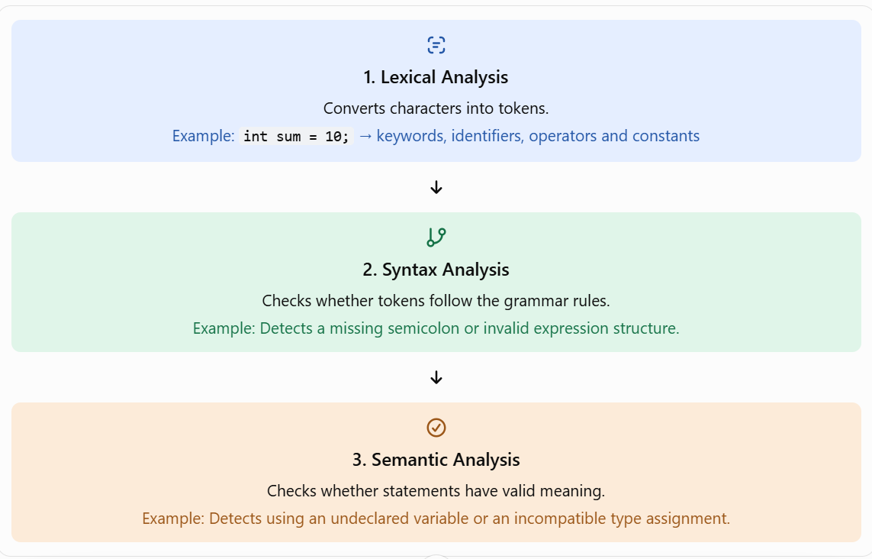
Three Main Phases of the Front-End
The front-end mainly consists of three important phases.

Slide 4
Intermediate Code Generation
What is intermediate code?
Intermediate representation (IR) is a form of code generated after the source program has been analyzed. It acts as a bridge between the front-end and the back-end.
Consider this C statement:
result = a + b * c;
A possible three-address intermediate representation is:
t1 = b * c
t2 = a + t1
result = t2
Here, t1 and t2 are temporary variables used to represent intermediate calculations.

Slide 5
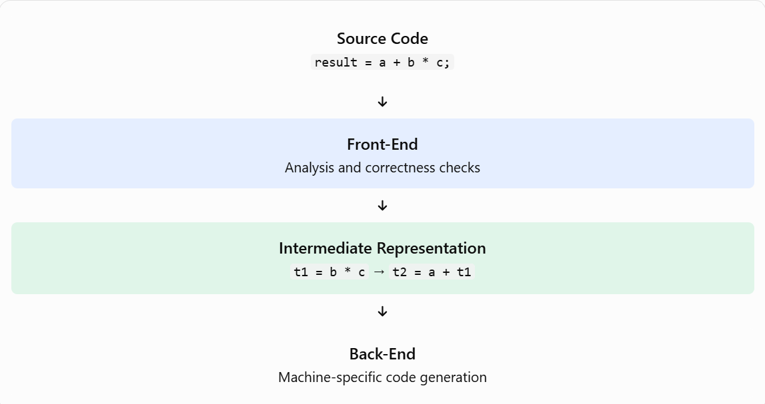

Slide 6
Characteristic | Simple explanation
Machine-independent | Focuses on the source language rather than a particular processor's instruction set.
Focuses on correctness | Detects lexical, grammatical and semantic errors.
Easier to modify | Language-specific changes can often be made without redesigning the entire back-end.
Generates intermediate code | Produces a representation for optimization and later code generation.
Modular design | Separates analysis into distinct phases, making development and debugging easier.
Important Characteristics of the Front-End
Practical example: If a compiler is extended to support a new programming language, much of the existing back-end may be reusable if the new front-end produces the same intermediate representation.
Important distinction: The front-end is largely machine-independent, but it is not necessarily independent of the source programming language. Also, it can detect many errors, but it cannot guarantee that a program's overall logic is correct.

Slide 7
Real-Life Example and Conclusion
Suppose a student writes this program:
int age = 20;
age = age + 1;
The front-end processes it step by step:
Lexical analysis
Recognizes int, age, =, 20 and other tokens.
Syntax analysis
Checks that the declaration and assignment follow C grammar.
Semantic analysis
Checks that age is declared and that the operations and types are valid.
Intermediate code generation
Creates an intermediate representation for the next compiler stages.
Conclusion
The compiler front-end is essential because it transforms source code into a structured intermediate representation while detecting errors early. Its modular, largely machine-independent design makes compilers easier to develop, maintain and extend.

Slide 8
